Slide 1

Personal Finance Manager
A comprehensive personal finance manager that allows users to track their income, expenses, savings and debts.
Specialise in offering budgeting advice and supporting financial goals.

Slide 2
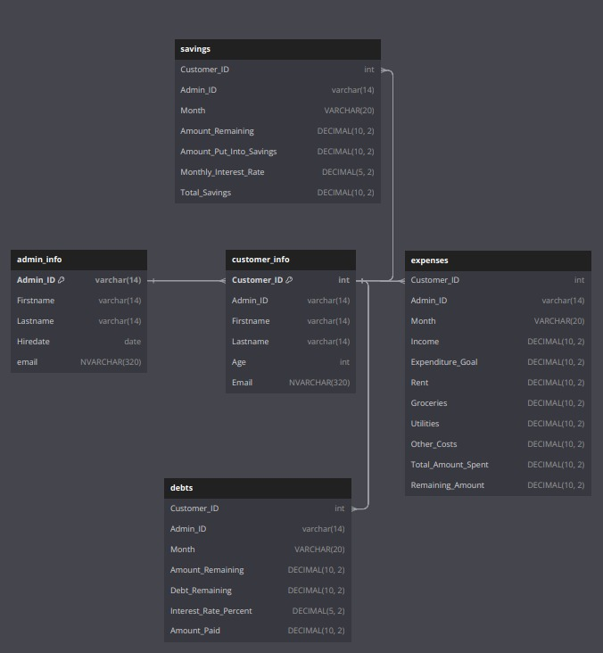
SQL
We used SQL to create a relational database with 5 different tables and inserted our own dummy data into it.
After producing the SQL database, we connected it directly to Python. The Python programme then ouputs the CSV file.

Slide 3

Python
We have used Python to create a Personal Finance Manager System.
Main Menu:
Log in System:
Admin Login,
Create Admin, Exit the system.
(Once logged in)
Admin Menu:
Customer Profile,
Expenses Report,
Savings Report,
Debt Report,
Add Customer Profile,
Modify Customer Profile, Savings Calculator,
Debt payoff Calculator, Update Admin Password,
Log out.
Our Idea:
Admins (financial consultants) use this system to view our customers' financial information, enabling them to offer budget advice and help set financial goals.
Our consultants will be trained on how to use this user-friendly system.
They will start by 'creating an admin'. They can then 'log in' using their username and encrypted password, each time they use the system.
Once logged in, our consultants can freely use the 'Admin Menu', shown to the left.
They can view and modify customers' personal and financial information, as well as calculating savings and debt payoff.
They can also modify their password at any time! We recommend they do this once a month, to ensure security.
When exiting the system, the relevant data is then exported into their appropriate CSV files

Slide 4

Excel
(The latest CSV file was downloaded from Python and used to analysis the data).
Please see full report : https://dcoates.atlassian.net/l/cp/4nwgjG1J
We used Excel to Analyse our Customers Finances.
The outcome of this analysis was used to offer budgeting advice to our customers in debt and set financial goals with our customers who save.
This analysis also helped us:
show examples of how our customers can increase their financial gains.
show us our customers best and worse months (based on their income remaining after expenses).
see which customers our financial consultants supports (and their financial situation).

Slide 5

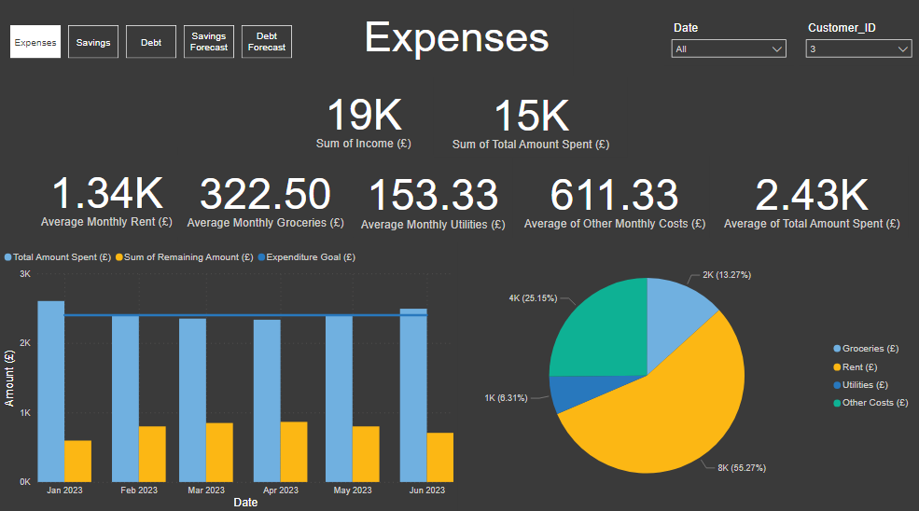
Power BI
We created some dashboards on Power BI for the admins to have a summary of all their customers finances.
It also allows us to forecast the user's debt and savings in the coming months.

Slide 6
Future Improvements
Python: - add features : investment (financial goals) and budgeting.

